Slide 1
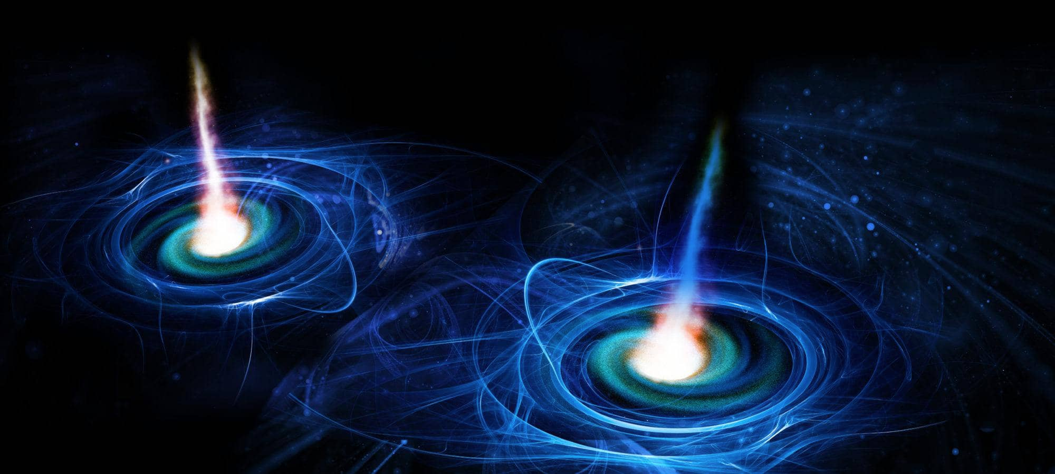



STOCHASTIC GRAVITATIONAL WAVE BACKGROUNDS
Stephen Taylor
Assistant Professor of Physics & Astronomy
VANDERBILT UNIVERSITY, Nashville TN
Chair, NANOGrav Collaboration
VU PTA GW Summer School, July 10 2024

Slide 2
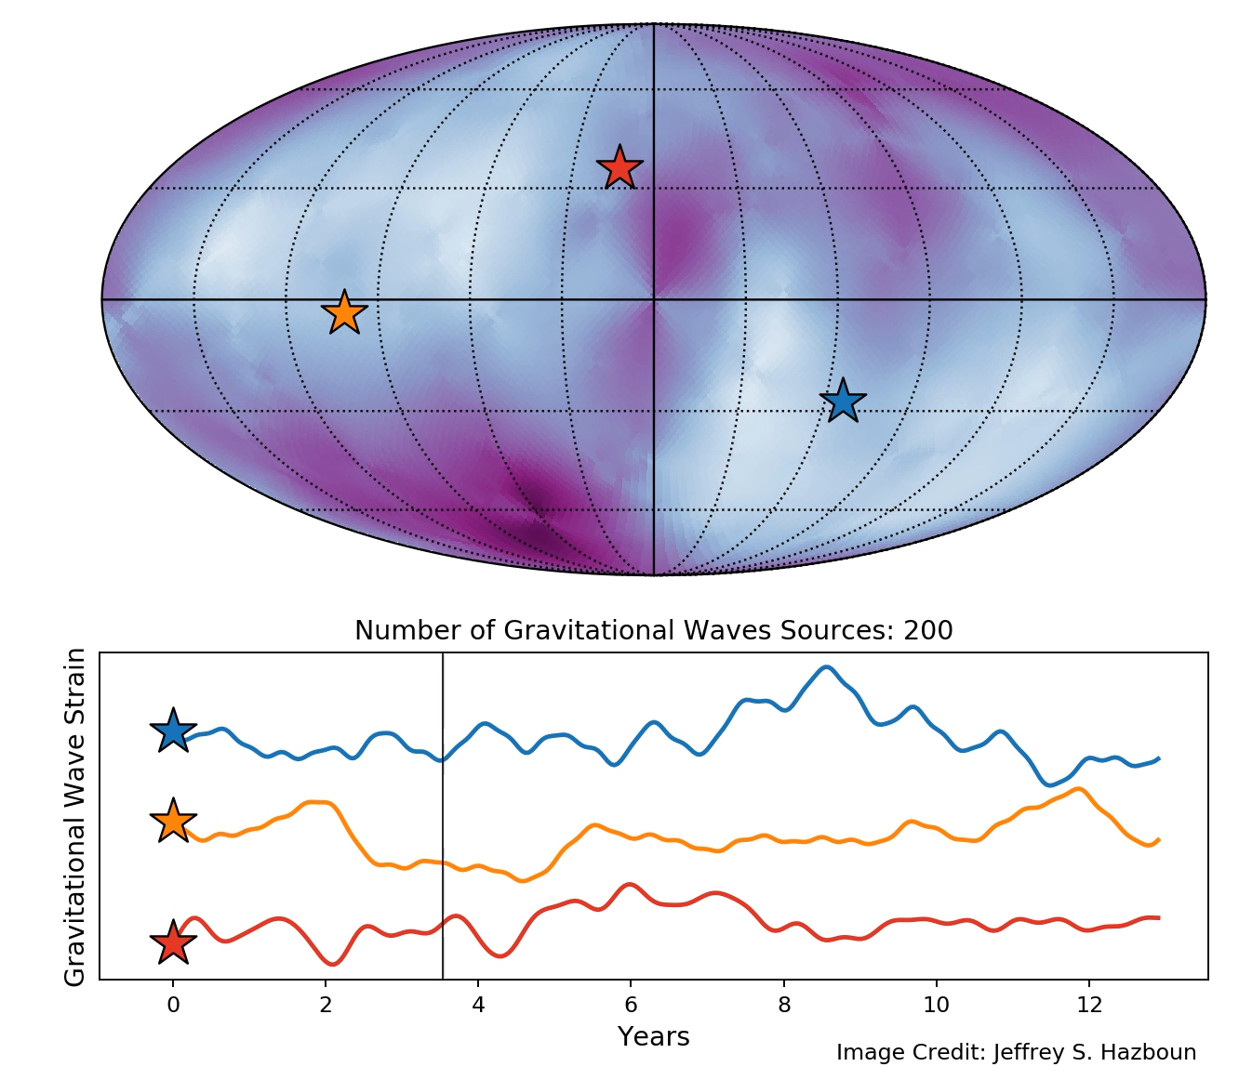
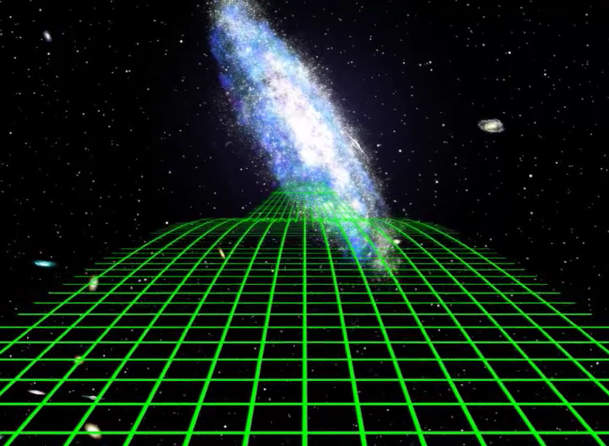


Pulsar Timing Arrays
1 pulsar
an array of pulsars
Stephen R. Taylor
VU PTA GW Summer School | July 10 2024
Notes:
Extra material from last slide, showing H&D curve.

Slide 3

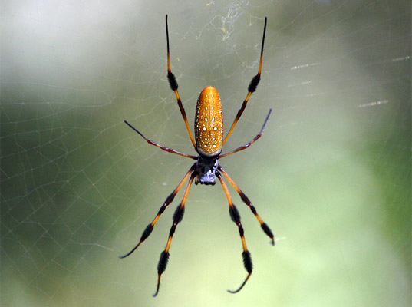

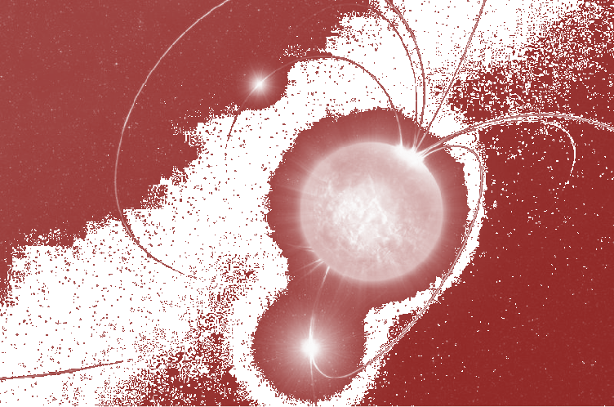
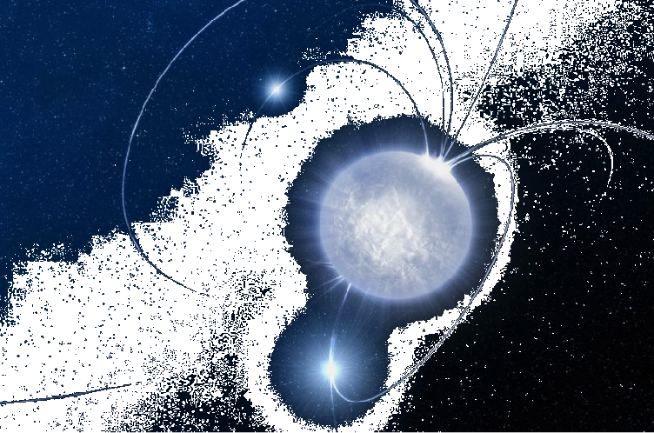

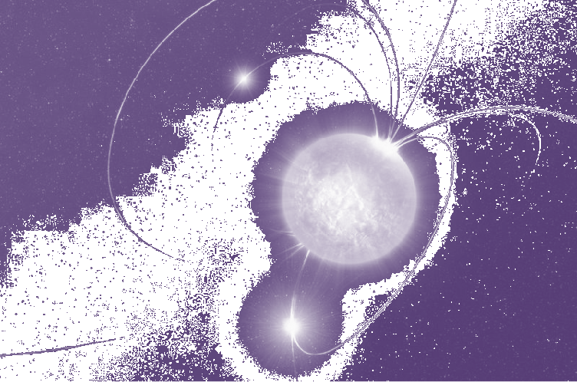

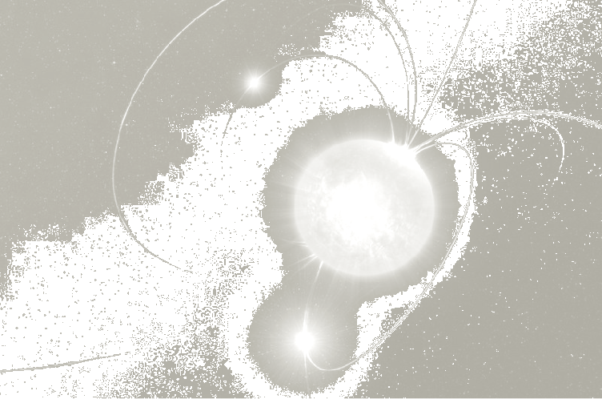
Credit: NANOGrav Space Public Outreach Team
Stephen R. Taylor
VU PTA GW Summer School | July 10 2024
Notes:
A spider at the center of a web can tell infer the presence of her prey through correlated vibrations in her legs.
A single pulsar suffers from noise processes that may be spectrally similar to a GW signature.
But an extra-galactic GW will immerse all pulsars in a common bath of of the metric perturbation, imparting a correlated signature.

Slide 4



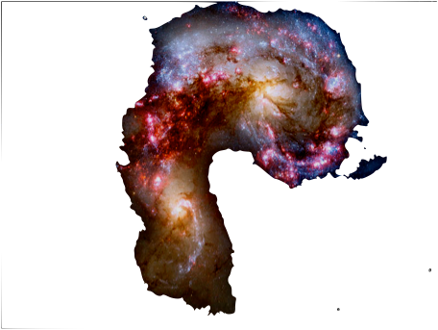
Credit: NANOGrav Space Public Outreach Team
Stephen R. Taylor
VU PTA GW Summer School | July 10 2024
Notes:
This is why we employ a Pulsar Timing Array.
For a stochastic background of Gas, the Earth-term will be statistically correlated across pulsars.
For an individual GW target, the correlations can be used to localize the source.

Slide 5
Derivation

Slide 6
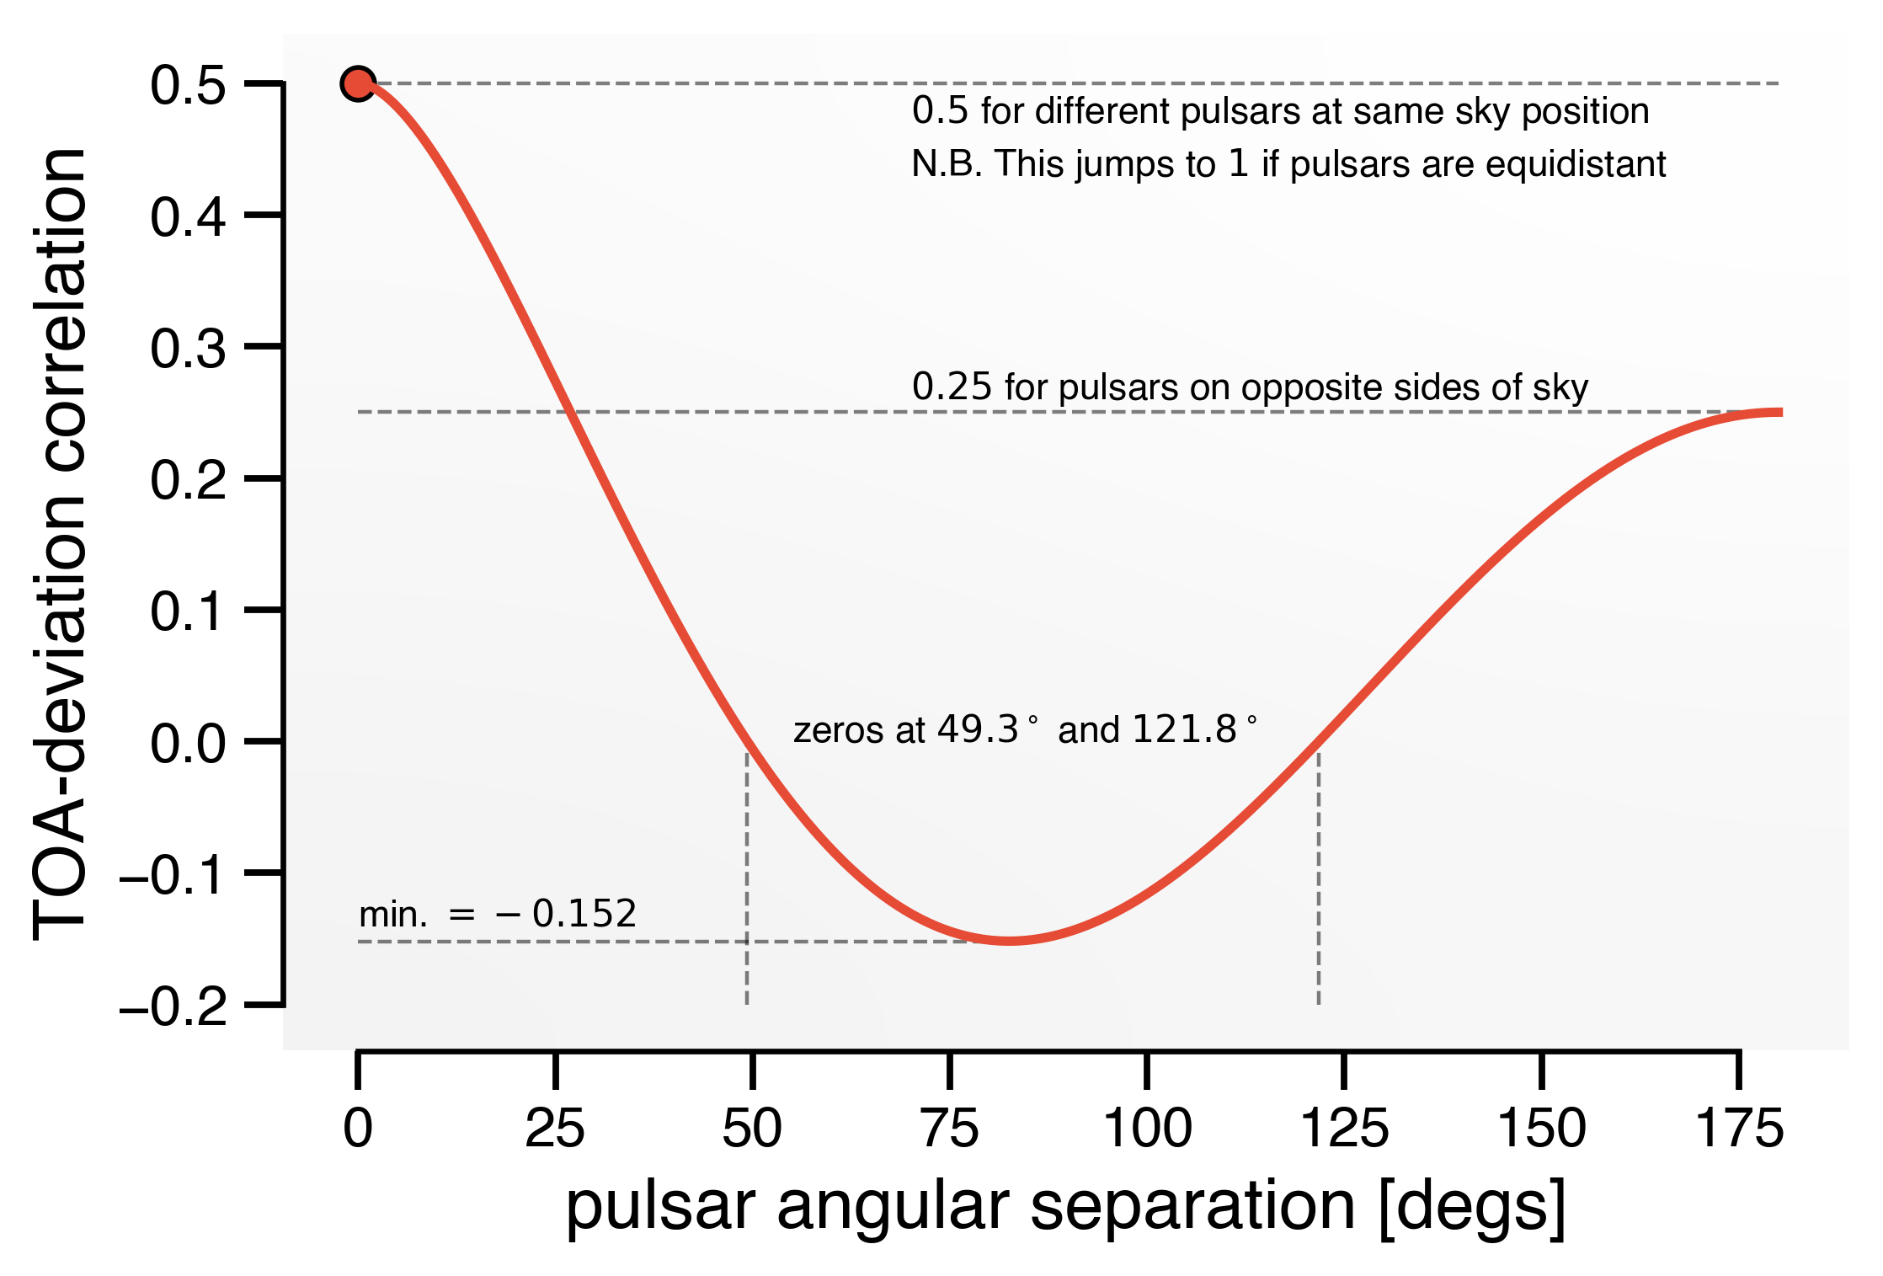
Detection
Detection based on quadrupolar correlation between pulsars.
(“Hellings & Downs curve”)
Many pulsars needed.
Other spatially correlated processes may include:
Global time-standard drifts (monopole)
Solar-system ephemeris errors (dipole)
Stephen R. Taylor
VU PTA GW Summer School | July 10 2024
Notes:
Extra material from last slide, showing H&D curve.

Slide 7
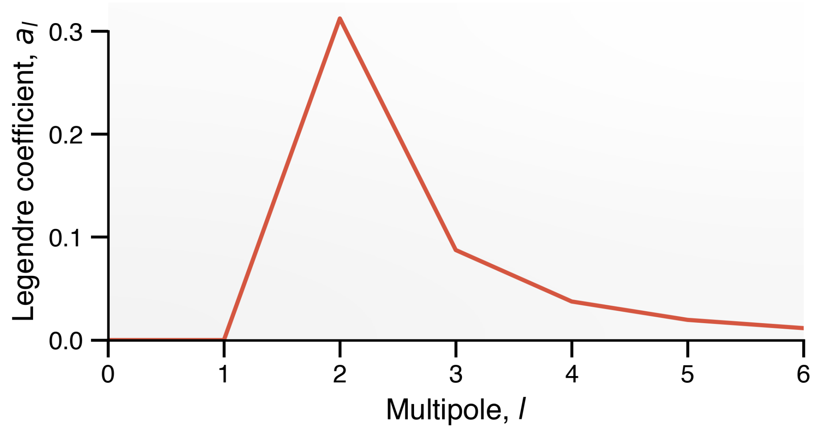
Detection
Stephen R. Taylor
VU PTA GW Summer School | July 10 2024
Notes:
Extra material from last slide, showing H&D curve.

Slide 8
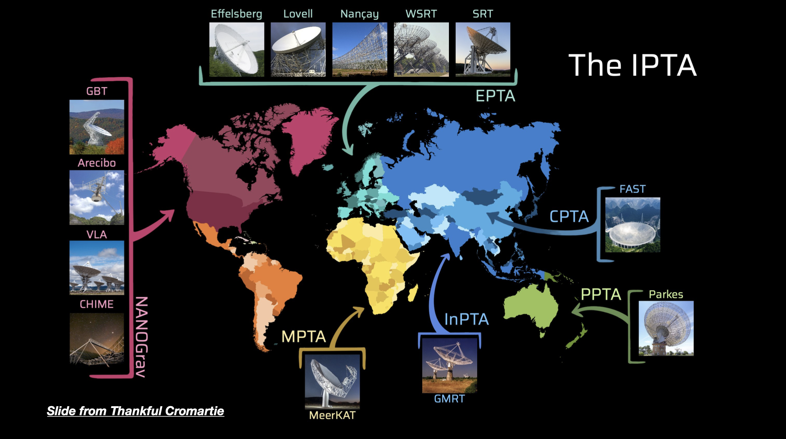
Stephen R. Taylor
NCfA Symposium | UNLV | Feb 23 2023
Notes:
At frequencies of ~0.1 to 100 mHz, the space-borne LISA detector will measure massive binary black holes in the mass range of ~1e4 to ~1e7 solar masses.
Will also measure the entire galactic white-dwarf binary population, as well as test gravity with extreme mass-ratio inspirals.
Operational in the mid-2030s.
At even lower frequencies, PTAs operate in the nanohertz GW frequency regime.
They are sensitive to the most massive binary compact objects in the Universe, as well as cosmic strings, primordial GWs, and other exotic physics.
Detection expected within the next 3-7 years. PTAs are the next frontier of GW astronomy; in detection mode before 3G ground-based or LISA.
Let’s talk more about the detection technique.

Slide 9
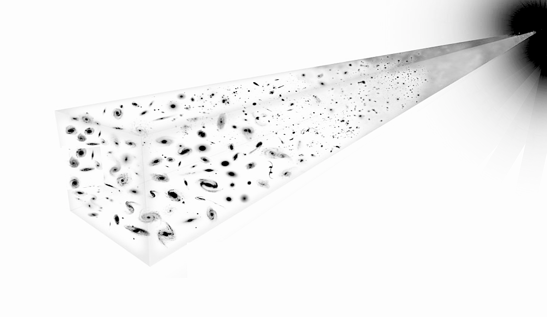
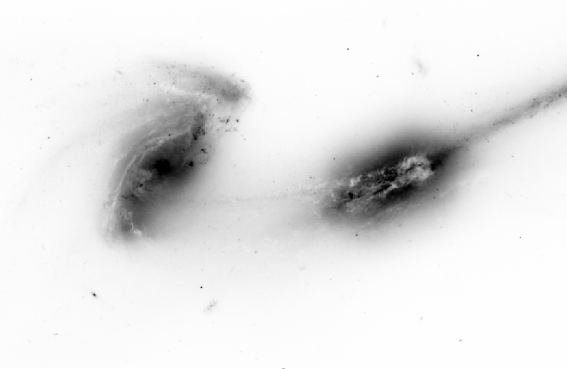
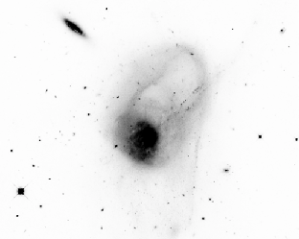

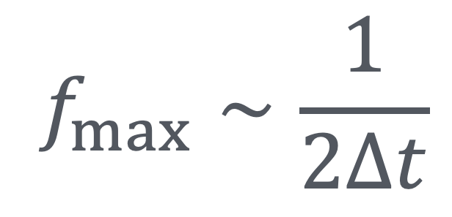
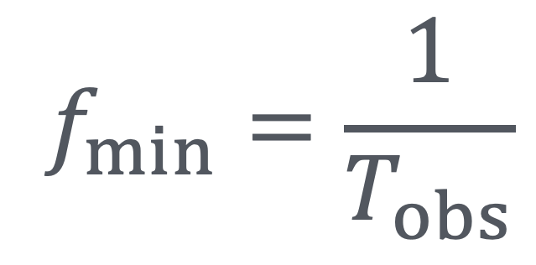

Supermassive Binary Black Holes
$$f_{min}=\frac{1}{T_{obs}}$$
$$f_{max}∼\frac{1}{2Δt}$$
= Supermassive Black Hole
Big Bang
$$∼2nHz$$
$$∼400nHz$$
Big Bang
Galaxies grow via mergers over cosmic time
Supermassive black holes pair within galactic merger remnant.
Stephen R. Taylor
VU PTA GW Summer School | July 10 2024
Notes:
Our frequency sensitivity is set by sampling of the pulse TOA time-series.
With ~decade-length observations we can probe down to a few nanohertz.
By sampling every few weeks we can probe up to ~few hundred nanohertz.
The dominant target in this band is a cosmological population of supermassive binary black holes.
These are a natural by-product of hierarchical galaxy growth, where small galaxies merge into larger ones over cosmic time.
It is now well accepted that most massive galaxies harbor a central supermassive black hole. As the galaxies merge, the resident SMBHs sink and “find” each other to form duals, then binaries.

Slide 10
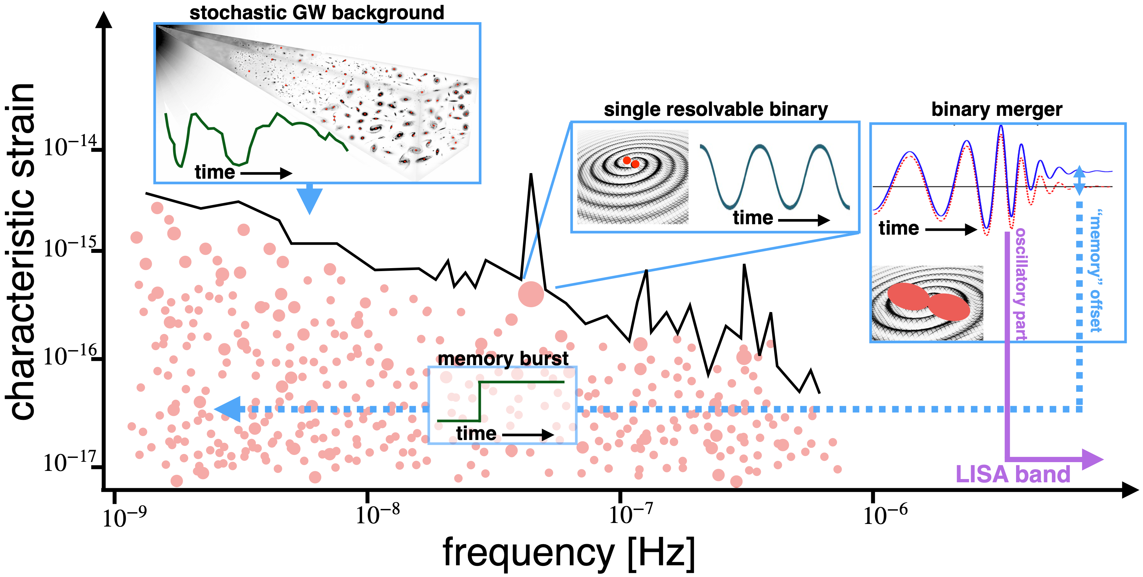
Supermassive Binary Black Holes
coalescence timescale can be Myrs
signal is present in entire data stream
Stephen R. Taylor
VU PTA GW Summer School | July 10 2024
Notes:
This is a cartoon of the different signal classes created by SMBBHs in the PTA sensitivity band.
SMBBHs take at least Myrs to merge. Signals are present in our entire data stream, appearing as small perturbations to baseline pulsar behavior and noise processes.
We expect that the first detected signal will be that of a stochastic GW background from the incoherent superposition of GW signals from the entire binary population.
After that, individual binaries will be detected, localized, and characterized.
Although we are not sensitive to the oscillatory merger signal (frequency is too high), we are sensitive to the “memory burst” offset predicted by GR. It is a constant DC offset, that manifests as a ramp in the timing residuals.

Slide 11
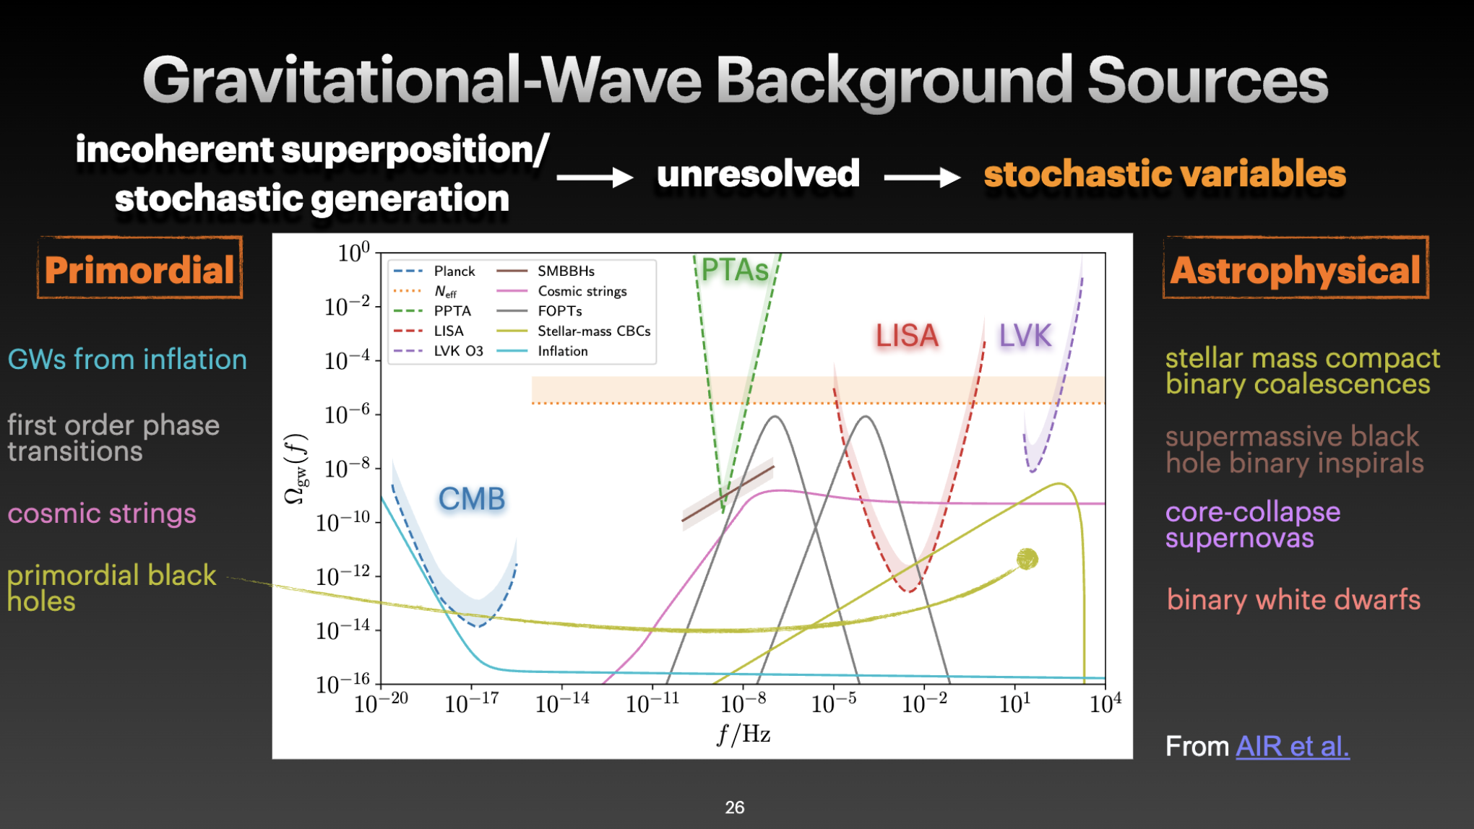
CREDIT: ARIANNA RENZINI

Slide 12
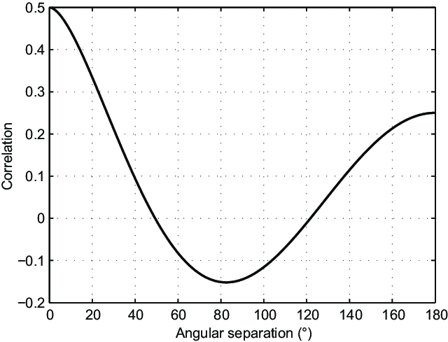
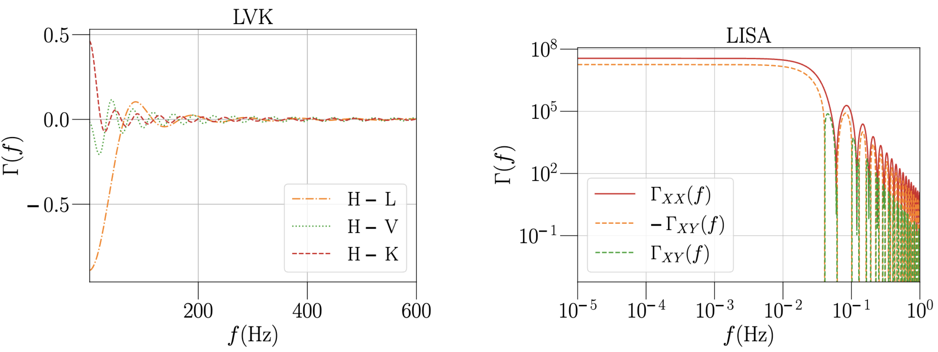


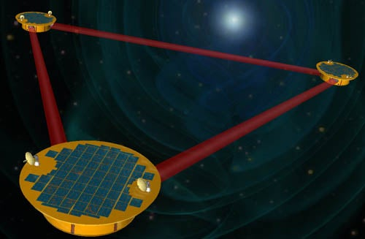
Stephen R. Taylor
VU PTA GW Summer School | July 10 2024

